Slide 1

PERSONAL DATA
Written by Vuong Nguyen Duc
Apply for Embedded Software Development Engineer Position

Slide 2


Content
1
Personal Information
2
Education
3
Working Experience
4
Personal Skills
5
Projects
6
Future Plans
1
Vượng Nguyễn

Slide 3
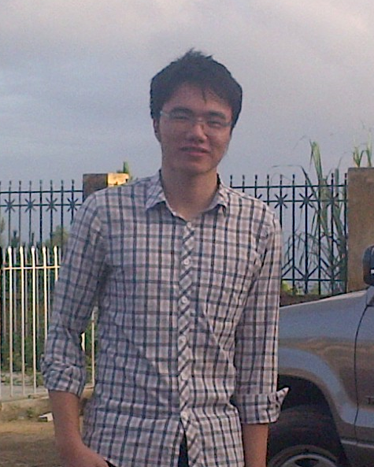
1. Persional Information
Fullname: Nguyễn Đức Vượng
Gender: Male
Date of birth: 20/01/1994
Place of birth: Namdinh, Vietnam
Contact details:
Phone number: 01685753613
Email: ducvuongbkhn@gmail.com
Character: Friendly, careful, hardworking, sincere
2
Vượng Nguyễn

Slide 4

2. Education
University:
From August 2012 to June 2017: Student of Hanoi University of Science and Teclonogy (HUST)
Major: Electronics and Telecommunications
GPA (current): 7.23/10
Certificate: TOEIC 590, Examination at Foreign Language Center of HUST (CFL)
3
Vượng Nguyễn

Slide 5
3. Working Experience
12/2016 – 5/2017: FPT Software company, FGA (FPT Global Automotive) Unit, department develop software for automakers
Job description: Develop software for automotive, using C/C++ language and Qt framework, build by toolchain (cross compiler) and run in Linux board (in automotive)
2015 – 12/2016: SIPLAB - Instruction by Assoc. Prof. Hoang Manh Thang belong Hanoi University ofScience and Technology
Laboratory research about electronics and telecommunications
Job description: Research and make product about hardware, linux embedded software and firmware
4
Vượng Nguyễn

Slide 6

4. Personal Skills
Software:
C/C++ language
Qt framework
Linux bash, shell
Hardware:
Design schematic and PCB layout
Hardware simulation
Design hardware with HDL as verilog, VHDL
Firmware: Microprocessor (ARM – STM32, MSP430,…)
GPIO, timer/counter, interrupt, ADC
Communications protocol: UART, I2C, SPI, Weigand,...
Mobile App: Android application with
Java (Android Studio IDE)
C/C++ (Qt Creator IDE and Qt Framework)
Office informatics: MS Word, powerpoint, excel, visio
5
Vượng Nguyễn

Slide 7
5. Projects (1)
Multimedia Application For Automotive (In FPT Software)
Develop for automotive, using Qt Framework, create GUI with QML and
Automatic Number Plate Recognition
Develop for Raspberry Pi (Board run Linux OS), used OpenCV and Qt Framework, from image input contain number plate, application process and return result is number plate text format
Robot Exploring Topography (Diploma Project)
Use architecture web server - client, car include a linux board connect with hardware control peripheral as motor, camera, GPS,..., GPS signal, pin level, video stream will be received and processed by linux board and put to web browser, in browser, use can control car through controllers (buttons, google maps...) in web page, project using Qt Framework
6
Vượng Nguyễn

Slide 8
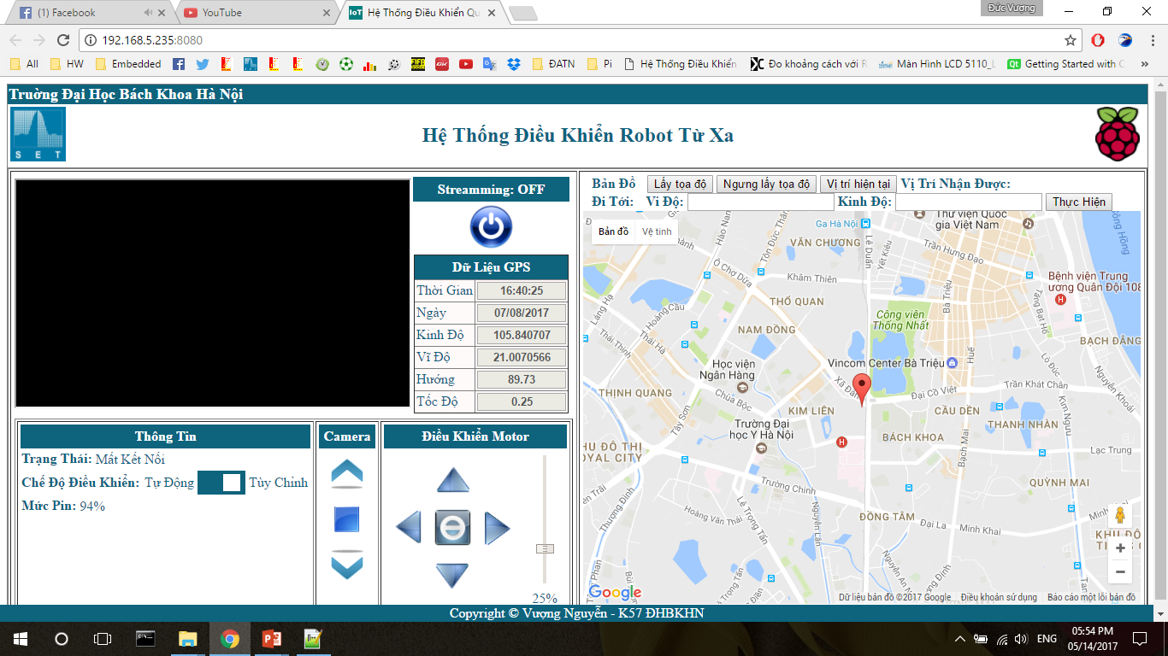
5. Projects (2)
7
Vượng Nguyễn

Slide 9

6. Future Plans
Knowledge:
Learn more about linux embedded software, Qt framework, linux core
Learn more about hardware, arm core, design board can embedded OS
Study English
Rank:
Become excellent embedded software engineer
Become team leader or project manager within 2 years
8
Vượng Nguyễn

Slide 10

Thank You
Notes:
In Slide Show mode, click the arrows to visit links.

